Slide 1
Community Health Workers
Essential for the Success of Healthcare Transformation

Slide 2
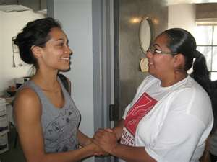
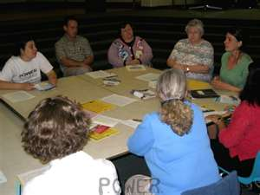

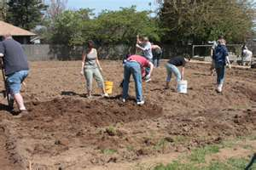
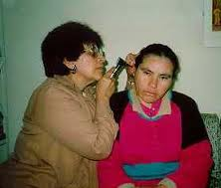
Who are Community health Workers (CHWs)?

Slide 3
APHA Definition
Community Health Workers (CHWs) are frontline public health workers who are trusted members of and/or have an unusually close understanding of the community they serve. This trusting relationship enables CHWs to serve as a liaison/link/intermediary between health/social services and the community to facilitate access to services and improve the quality and cultural competence of service delivery. CHWs also build individual and community capacity by increasing health knowledge and self-sufficiency through a range of activities such as outreach, community education, informal counseling, social support and advocacy. (American Public Health Association, 2008)

Slide 4
History in Oregon
1960s: Indian Health Service Community Health Representative (CHR) program begins nationwide.
1970s: Outreach workers are hired at Kaiser Neighborhood Health Clinic in Portland.
1988: Doctors at La Clínica del Cariño in Hood River found the El Niño Sano Program.
1995-1998: CHWs and allies from Oregon are at the forefront of the Natl. Community Health Advisor Study, the first national policy study about CHWs.

Slide 5
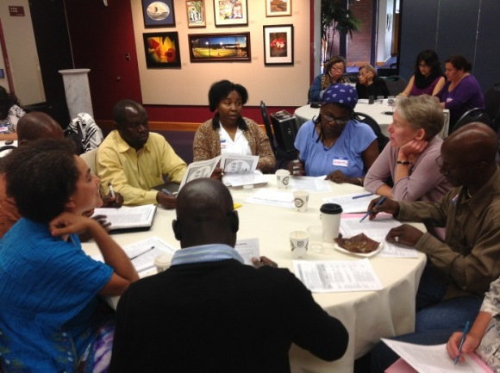
History Continued
2002: The Multnomah County Health Dept. establishes the Community Capacitation Center to provide credit-bearing training for CHWs.
2002-2005: Poder es Salud/Power for Health is funded by the Centers for Disease Control and Prevention.
2011:
  HB 3650 - Requires State to establish criteria, descriptions, and education/training requirements for community health workers, peer wellness specialists, personal health navigators, and other providers not regulated by the State
  September: a Subcommittee established to advise the Workforce Committee and the Health Policy Board on standards for Community Health Workers, Personal Health Navigators, Peer Wellness Specialists, Doulas
  November: ORCHWA established with support from The Community Capacitation Center of the MCHD, The Oregon Latino Health Coalition & The Northwest Primary Care Association.

Slide 6
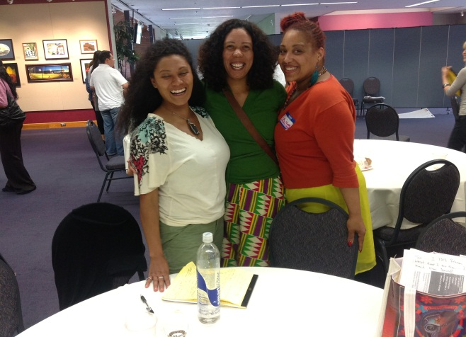
Meeting the Triple aim
CHWs support achieving the triple aim of
improved patient care
improved population health
cost savings

Slide 7


Cost Savings
Denver
Returns of $2.28 to $4.80 for every dollar spent
Baltimore
40% decrease in ER visits
33% decrease in ER admissions
33% decrease in total hospital admissions
Hawaii
Asthma related per capita charges decreased from $735 to $181
Notes:
Thanks to OEI for this slide

Slide 8
Traditional Health Workers*
Include:
-Community Health Workers
-Peer Wellness Specialists
-Doulas
-Personal Health Navigators
Currently referred to as “Non-Traditional”

Slide 9
Oregon Employment Survey - 2012
501 establishments surveyed: 156 responded
70/156 currently employ THWs
Average wage: $15.03 (range: $8.95-$33.66)
Out of the 690 currently employed, 394 THWs work in the Portland Metro region
100 different job titles

Slide 10
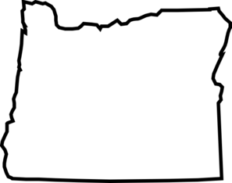

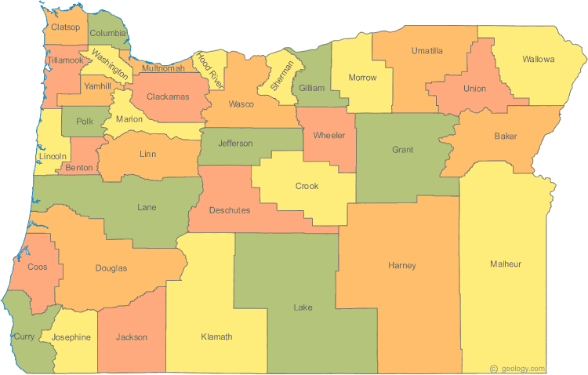

FUNDING
OREGON
Coordinated Care Organizations
Non-traditional health workers
CBOs
Hospitals
PCPCHs
Notes:
CCOs can both directly hire NTHWs (indicated with group of people on right) or will fund CBOs, PCPCHs and hospitals to hire NTHWs.

Slide 11
CERTIFICATION PATHS
Provisional Certification
Grandparenting
Completion of ANY 40+ Hour NTHW Training Program
Standard Certification
3000 Hours NTHW Work or Volunteer Experience
Application and Approval for One Year Provisional Certification
Possible Equivalency for Previously Completed Training
Pre-Course Assessment + Employer Competency Evaluation(s)
OHA- APPROVED TRAINING PROGRAM
CHW, PWS, NAV Core Curriculum
Doula Curriculum
Completion of All Remaining Required Training
OHA Approves Previously Completed Program
CHW, PWS or NAV Additional Curriculum
Incumbent Worker Training
OHA
Completed Application + Criminal Background Check
FULLY CERTIFIED AND ENROLLED IN REGISTRY (3 YEARS)
Notes:
Certification and Registry Enrollment Pathways for NTHWs
Completion of all requirements through an Authority approved training program for a NTHW type
CHW/PWS/PhNav: Authority approved 80 hours core curriculum + any additional training specific to NTHW type
Doula: Authority approved doula training OR DONA/ALACE certification+6 hrs cultural competency training
Option of applying equivalency for previous training, granted at discretion of training program
RATIONALE: Individuals should be able to apply prior applicable training to meet all the OHA training requirements
Grandfathering for prior experience
RATIONALE: Individuals who already have knowledge and skills from their prior NTHW work experience should be certified with only minimal training to fill any competency gaps
3000 hours of work or volunteer experience in the last 5 years
Incumbent worker training, determined at the discretion of training program using
Competency evaluation from at least one previous employer (OHA standard form)
Pre-course assessment designed by training program
One-year provisional certification for individuals who successfully complete a training program, not yet Authority approved
RATIONALE: Individuals who, in good faith, have already completed or are in the middle of completing a training program prior to the filing of these rules should qualify for temporary certification, during which they will fulfill the rest of the requirements.
Eligible for provisional certification following completion of any 40+ hour NTHW training program provided that the individual completed or matriculated in the training program within last 3 years (February 4, 2010-February 4, 2013)
Can become fully certified through:
Completion of remaining requirements at an Authority approved training program within the provisional year OR
Authority approval of the same training program that the individual had completed
OHA will conduct criminal background check of all applicants in accordance with OAR chapter 943, division 7
3 year renewal period for certification/registry enrollment
Minimum 20 hours continuing education every 3 years

Slide 12

ORCHWA is a membership organization and is led and directed by CHWs.
Beyond unifying and strengthening the professional identity of Oregon CHWs, ORCHWA seeks to support CHWs to obtain additional training, provide important networking opportunities, and facilitate CHWs and CHW programs to collaborate with each other, and community, government, health, and educational institutions.
ORCHWA’s members play an active and visible role in educating public health and health system professionals about the value of CHWs as well as addressing relevant policy and sustainability issues including: training, certification, employment opportunities, etc.

Slide 13
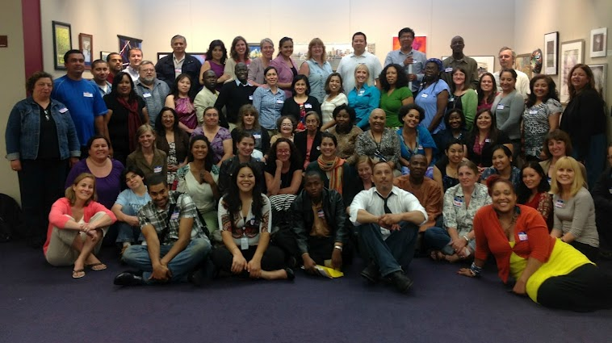
ORCHWA Strengthens the CHW workforce by:
-Unifying and strengthening the professional identity of Oregon CHWs
-Educating the public and health system professionals about the value of CHWs
-Addressing relevant policy and sustainability issues, as well as advocating for the expansion of CHW field (or the integration of CHWs into the health care, public health, and human services workforce).

